Slide 1
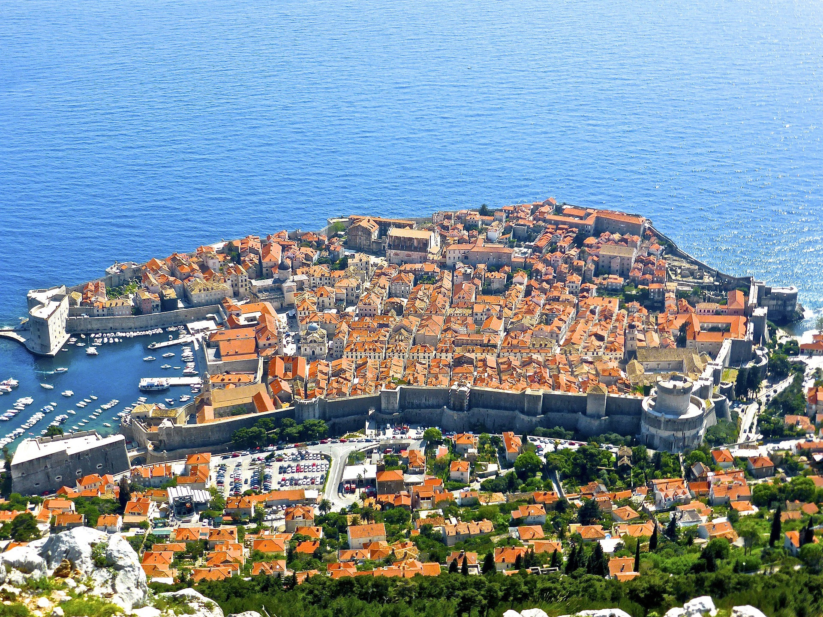

IEEE PES ISGT
Europe 2024
Conference
Dubrovnik, Croatia
October 14th - 17th
Title:
Authors:
Affiliation:

Slide 2
IEEE PES Innovative Smart Grid Technologies Conference Europe (ISGT- Europe)
October 14th – 17th, 2024, Dubrovnik, Croatia

Slide 3
IEEE PES Innovative Smart Grid Technologies Conference Europe (ISGT- Europe)
October 14th – 17th, 2024, Dubrovnik, Croatia

